Slide 1
artificial intelligence in psychiatry
Mojib heidarian

Slide 2
artificial intelligence in psychiatry
mental health conditions and provide better patient care
early detection
diagnosed based on an individual’s self-report to specific questionnaires designed for the detection of specific patterns of feelings or social interactions
artificial intelligence (AI) and machine learning (ML) technologies are being applied to improve our understanding of mental health conditions

Slide 3
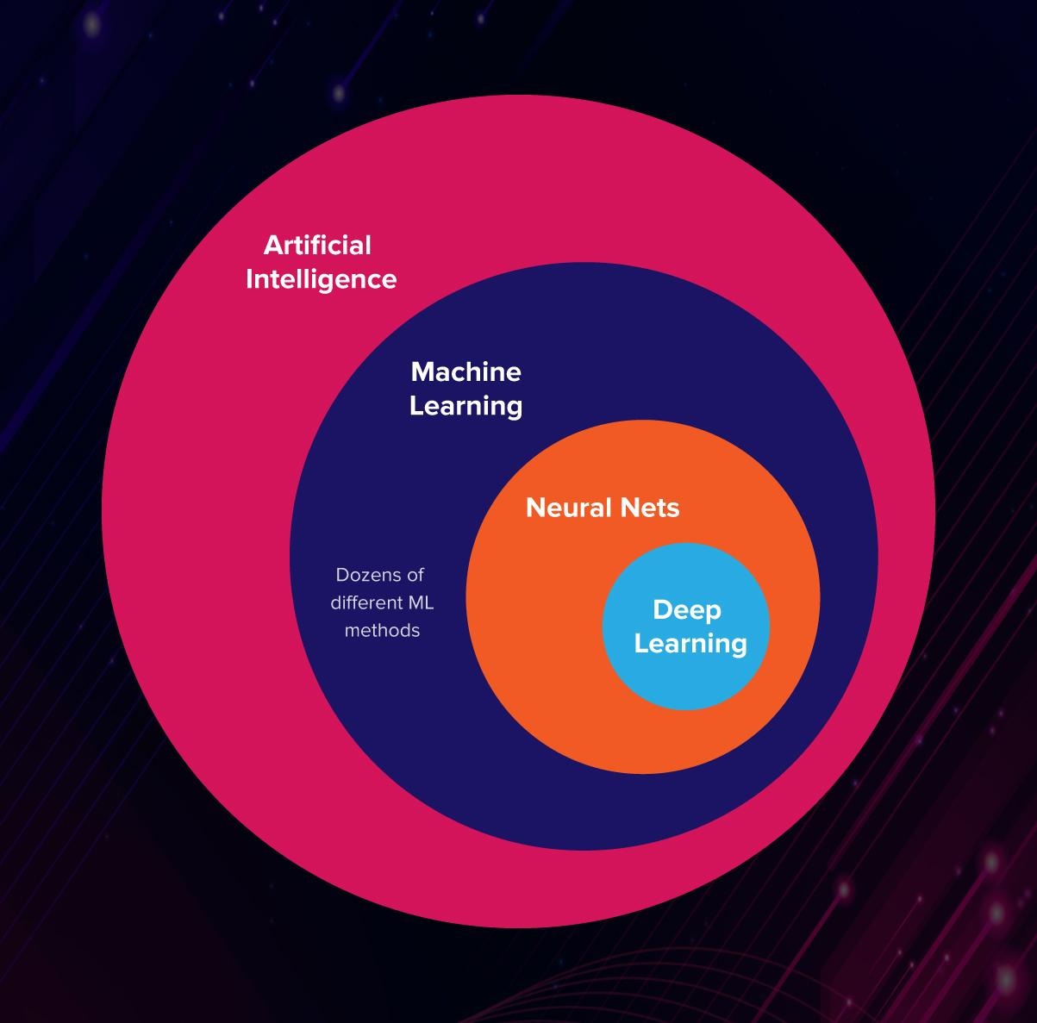
Artificial intelligence
Machine learning
Neural network
Deep learning
Notes:
هر گاه یک ماشین وظایفش برای حل مسئله را بر اساس قوانین پیش بینی شده (الگوریتم ها) انجام دهد، یعنی رفتاری هوشمندانه بروز داده و این همان مفهوم هوش مصنوعی(AI) است.
این چنین ماشین هایی می توانند اشیاء را جا به جا و یا دستکاری کنند . برای مثال رباتی که می تواند دستش را بالا ببرد، نمونه ای از هوش مصنوعی(AI) محسوب می شود.
AIدر واقع به ماشین اجازه می دهد تا مثل انسان فکر کند ، یاد بگیرد. در نتیجه ماشین می تواند از تجربیات خود بیاموزد.
به طور کلی هوش مصنوعی به دو دسته ی هوش مصنوعی عمومی و هوش مصنوعی محدود یا ضعیف تقسیم می شود.
هوش مصنوعی ضعیف(ANI)
هوش مصنوعی عمومی( AGI)

Slide 4
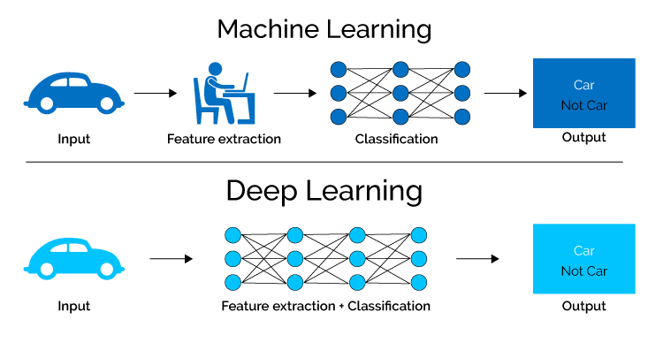

Slide 5
Machine learning

Slide 6
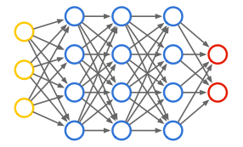
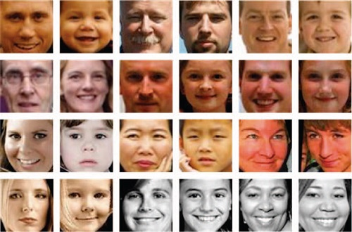
Deep learning

Slide 7
data
prepressing
model
evaluation

Slide 8
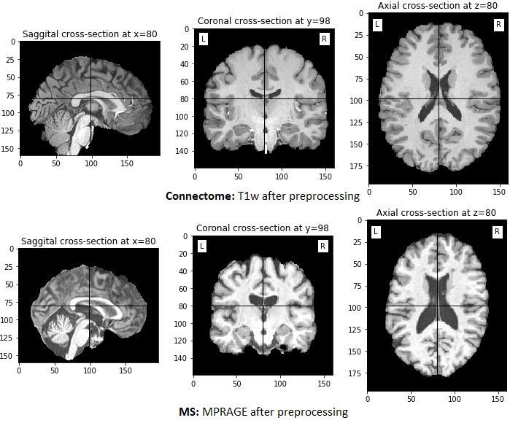
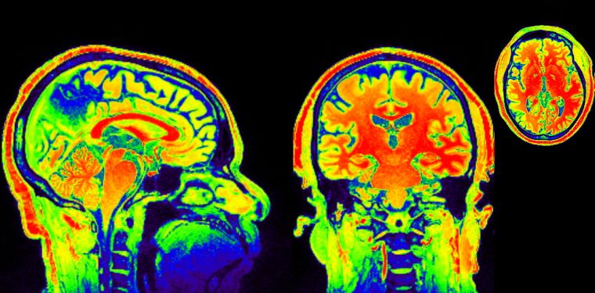
Neuroimages
Previous studies have shown that neuroimages can record evidence of neuropsychiatric disorders22,23. Two common types of neuroimage data analyzed in mental health studies are functional magnetic resonance imaging (fMRI) and structural MRI (sMRI) data. In fMRI data, the brain activity is measured by identification of the changes associated with blood flow, based on the fact that cerebral blood flow and neuronal activation are coupled24. In sMRI data, the neurological aspect of a brain is described based on the structural textures, which show some information in terms of the spatial arrangements of voxel intensities in 3D. Recently, DL technologies have been demonstrated in analyzing both fMRI and sMRI data

Slide 9
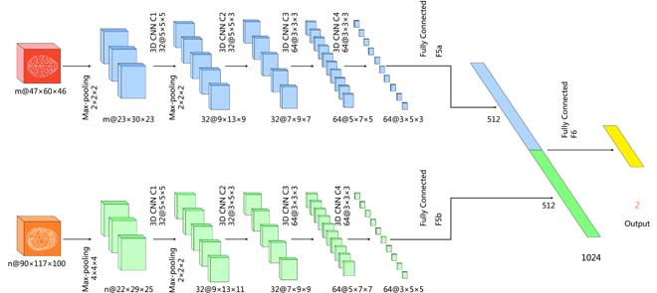
ADHD (Attention deficit hyperactivity disorder)
One application of DL in fMRI and sMRI data is the identification of ADHD25,26,27,28,29,30,31. To learn meaningful information from the neuroimages, CNN and deep belief network (DBN) models were used. In particular, the CNN models were mainly used to identify local spatial patterns and DBN models were to obtain a deep hierarchical representation of the neuroimages. Different patterns were discovered between ADHDs and controls in the prefrontal cortex and cingulated cortex.

Slide 10
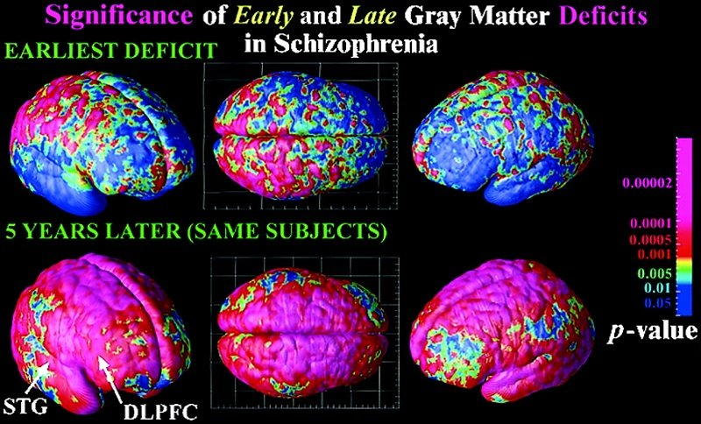
schizophrenia
Also, several studies analyzed sMRIs to investigate schizophrenia, where DFNN, DBN, and autoencoder were utilized. These studies reported abnormal patterns of cortical regions and cortical–striatal–cerebellar circuit in the brain of schizophrenia patients, especially in the frontal, temporal, parietal, and insular cortices, and in some subcortical regions, including the corpus callosum, putamen, and cerebellum. Moreover, the use of DL in neuroimages also targeted at addressing other mental health disorders

Slide 11
Multi-Site Diagnostic Classification of Schizophrenia Using Discriminant Deep Learning with Functional Connectivity MRI
Abstract
Background: A lack of a sufficiently large sample at single sites causes poor generalizability in automatic diagnosis classification of heterogeneous psychiatric disorders such as schizophrenia based on brain imaging scans. Advanced deep learning methods may be capable of learning subtle hidden patterns from high dimensional imaging data, overcome potential site-related variation, and achieve reproducible cross-site classification. However, deep learning-based cross-site transfer classification, despite less imaging site-specificity and more generalizability of diagnostic models, has not been investigated in schizophrenia.
Methods: A large multi-site functional MRI sample (n = 734, including 357 schizophrenic patients from seven imaging resources) was collected, and a deep discriminant autoencoder network, aimed at learning imaging site-shared functional connectivity features, was developed to discriminate schizophrenic individuals from healthy controls.
Findings: Accuracies of approximately 85·0% and 81·0% were obtained in multi-site pooling classification and leave-site-out transfer classification, respectively. The learned functional connectivity features revealed dysregulation of the cortical-striatal-cerebellar circuit in schizophrenia, and the most discriminating functional connections were primarily located within and across the default, salience, and control networks.
Interpretation: The findings imply that dysfunctional integration of the cortical-striatal-cerebellar circuit across the default, salience, and control networks may play an important role in the "disconnectivity" model underlying the pathophysiology of schizophrenia. The proposed discriminant deep learning method may be capable of learning reliable connectome patterns and help in understanding the pathophysiology and achieving accurate prediction of schizophrenia across multiple independent imaging sites.

Slide 12
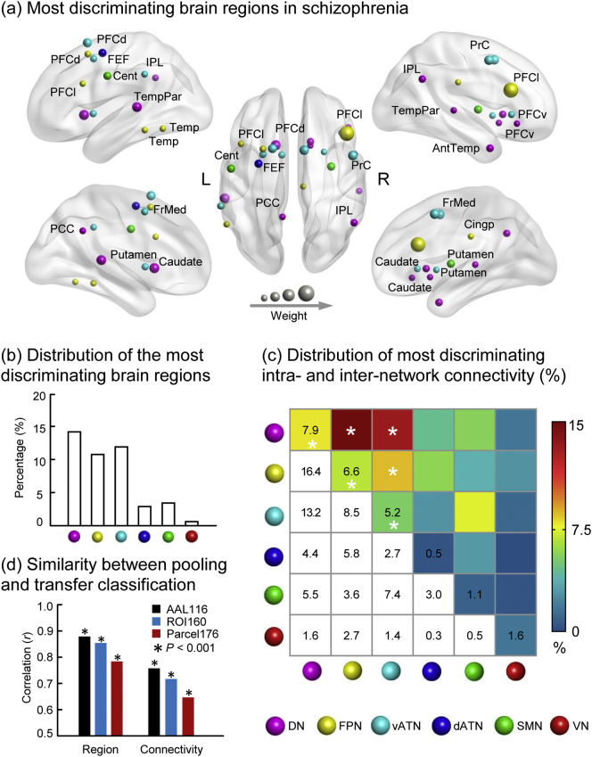
Most discriminating brain regions and functional connectivity in schizophrenia. (A) Most discriminating brain regions in schizophrenia. (B) Percentages of the most discriminating brain regions of each network. (C) Percentages of most discriminating functional connectivity within and between brain networks. (D) The region weights (R = 0·88, 0·86, and 0·79 for the AAL template, 160 ROIs, and 17-network parcellation, respectively, P < 0·001) and connectivity weights (R = 0·76, 0·72, and 0·65 for the AAL template, 160 ROIs, and 17-network parcellation, respectively, P < 0·001) obtained in the leave-site-out transfer classification were quite similar with those in the ten-fold multi-site pooling classification. Regions are color-coded by category and are scaled with their discriminative power. DN, default network; FPN, frontoparietal control network; vATN, ventral attention network; dATN, dorsal attention network; SMN, somatomotor network; VN, visual network; L/R, left/right.

Slide 13
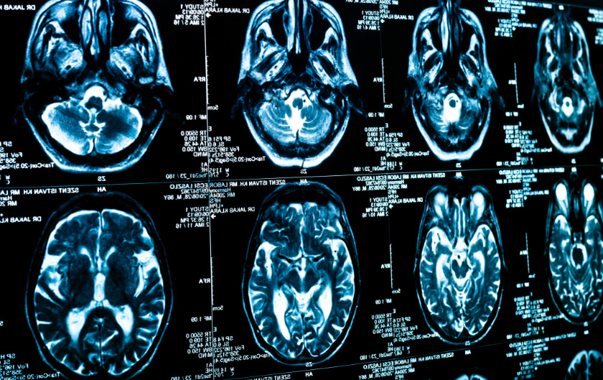
Geng et al.37 proposed to use CNN and autoencoder to acquire meaningful features from the original time series of fMRI data for predicting depression.
Two studies31,38 integrated the fMRI and sMRI data modalities to develop predictive models for ASDs. Significant relationships between fMRI and sMRI data were observed with regard to ASD prediction

Slide 14
Challenges and opportunities of DL in neuroimages
First:
multiple challenges need to be addressed to achieve this objective. First, DL architectures generally require large data samples to train the models, which may pose a difficulty in neuroimaging analysis because of the lack of such data
Second:
typically the imaging data lie in a high-dimensional space, e.g., even a 64 × 64 2D neuroimage can result in 4096 features. This leads to the risk of overfitting by the DL models.

Slide 15
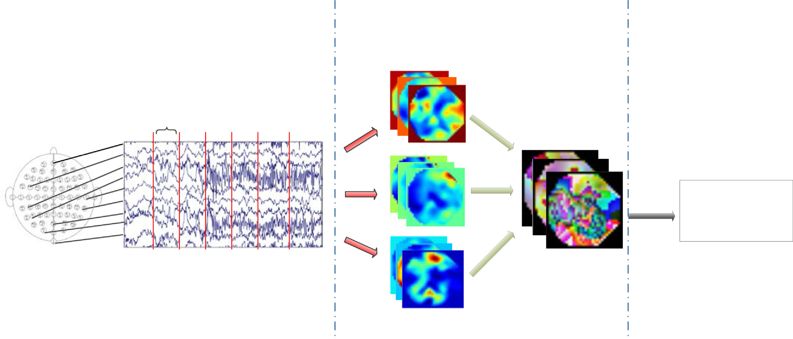
Electroencephalogram data
As a low-cost, small-size, and high temporal resolution signal containing up to several hundred channels, analysis of electroencephalogram (EEG) data has gained significant attention to study brain disorders42. As the EEG signal is one kind of streaming data that presents a high density and continuous characteristics, it challenges traditional feature engineering-based methods to obtain sufficient information from the raw EEG data to make accurate predictions. To address this, recently the DL models have been employed to analyze raw EEG signal data.
EEG is the preferred diagnostic tool in this research as it is non-invasive, economical, and easy to operate whereas the Magnetic Resonance Imaging (MRI) machine is expensive. Furthermore, the EEG records the brain’s electrical activity over a period of time while the MRI machine captures the changes in blood flow of the brain within seconds to a minute.

Slide 16
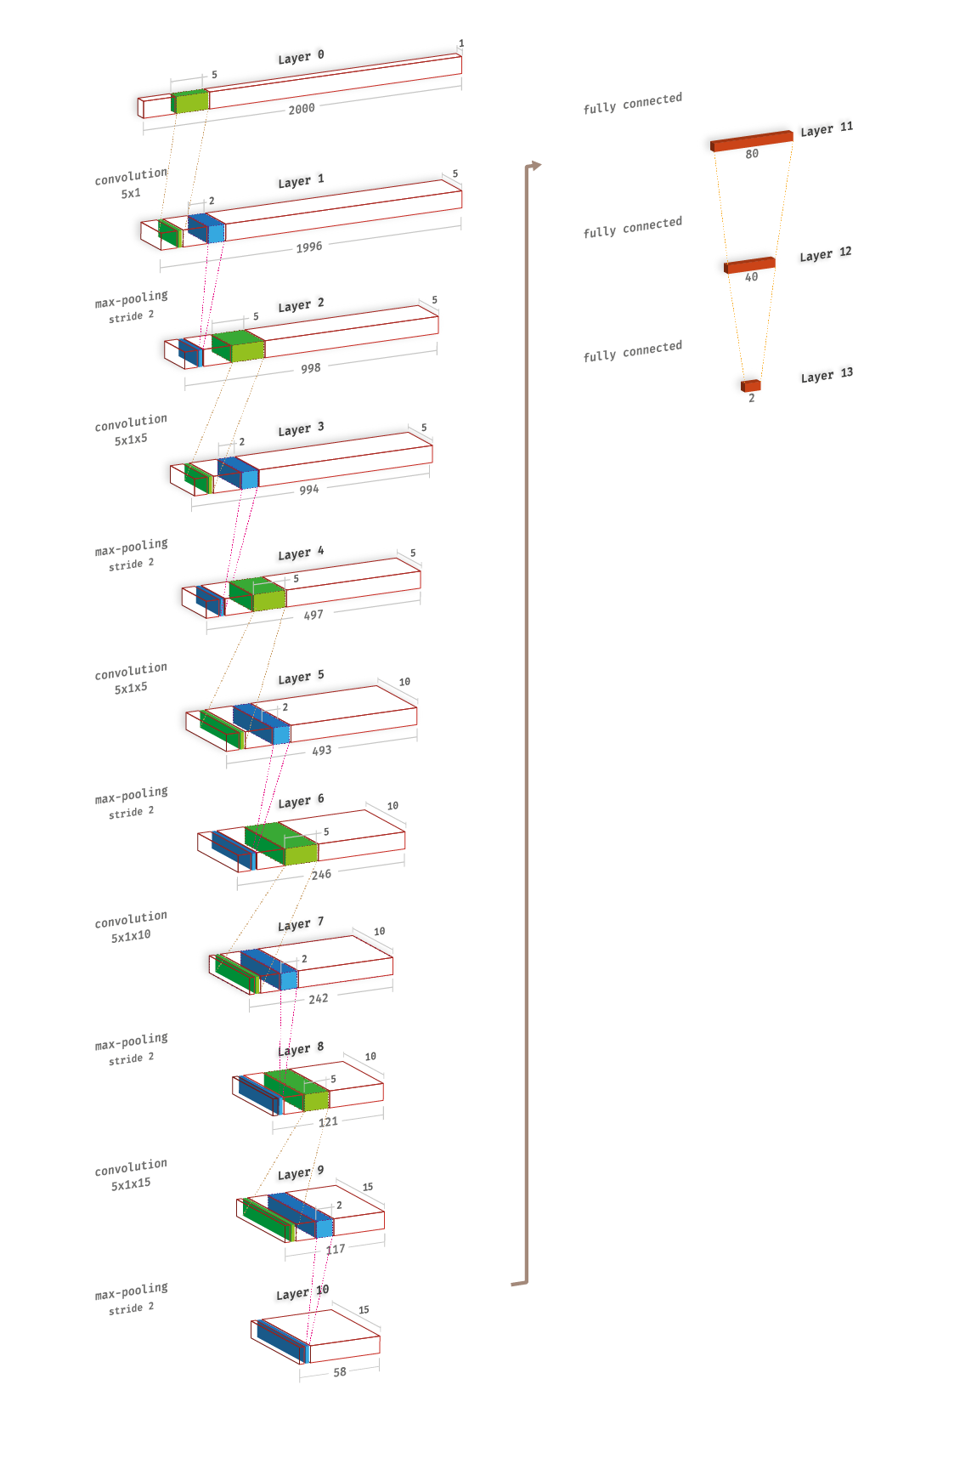
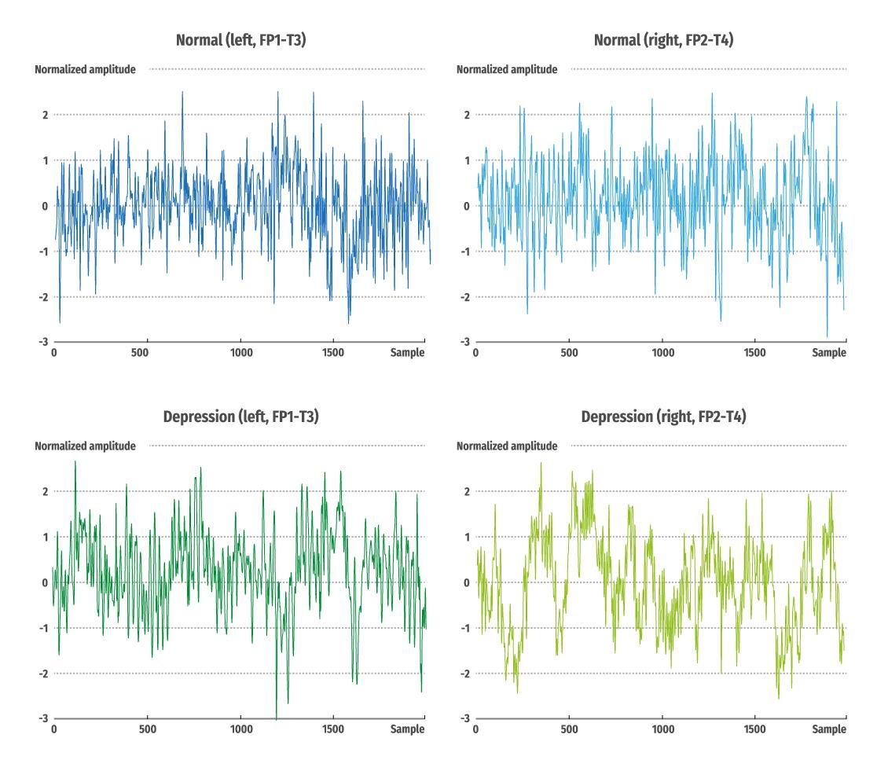
depression
Acharya et al.43 used CNN to extract features from the input EEG signals. They found that the EEG signals from the right hemisphere of the human brain are more distinctive in terms of the detection of depression than those from the left hemisphere. The findings provided shreds of evidence that depression is associated with a hyperactive right hemisphere

Slide 17
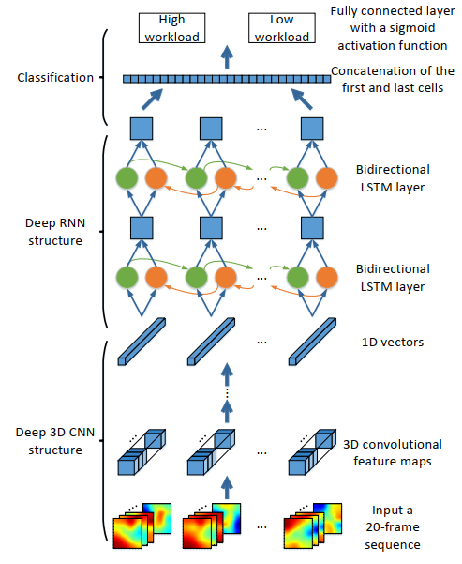
MENTAL workload
MENTAL workload significantly affects human performance in specific tasks. An appropriate mental workload can increase work efficiency. However, a heavy mental workload can decrease humans abilities in terms of memory, reaction and operation.
Zhang et al.45 proposed a concatenated structure of deep recurrent and 3D CNN to obtain EEG features across different tasks. They reported that the DL model can capture the spectral changes of EEG hemispheric asymmetry to distinguish different mental workload effectively

Slide 18
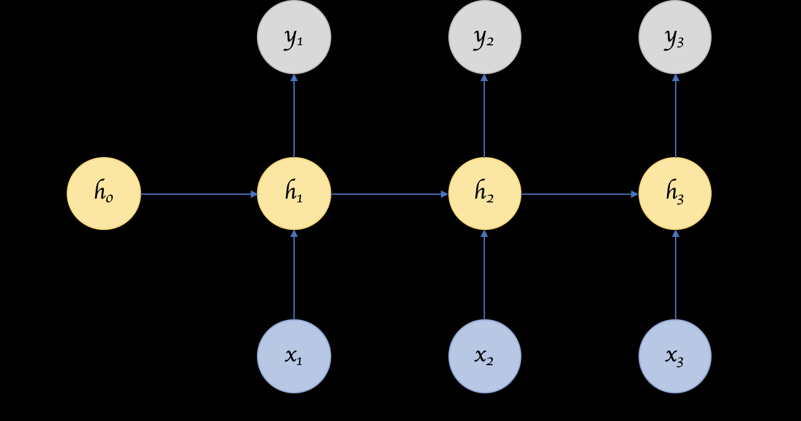
recurrent neural network

Slide 19
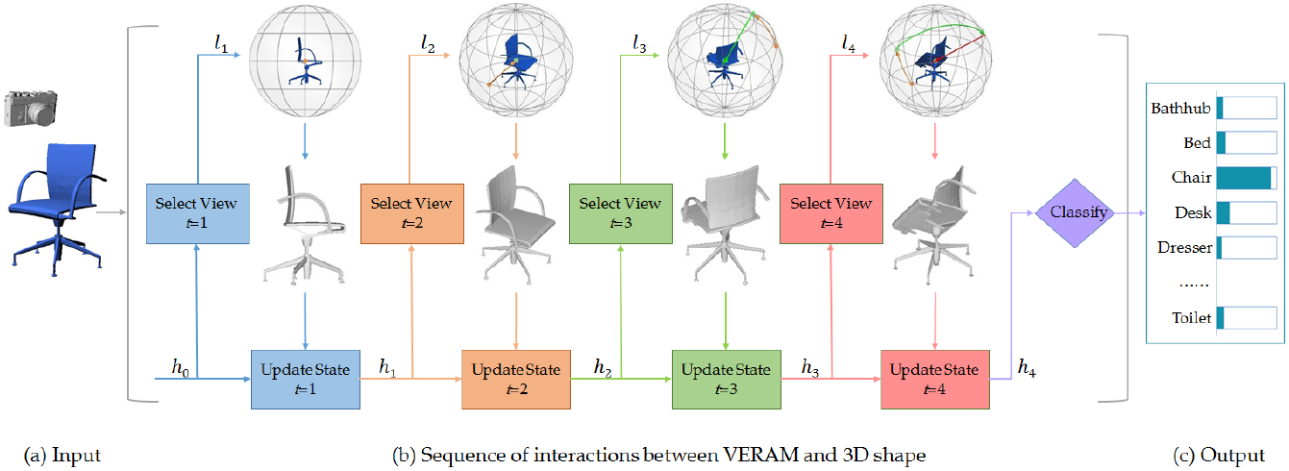

Slide 20
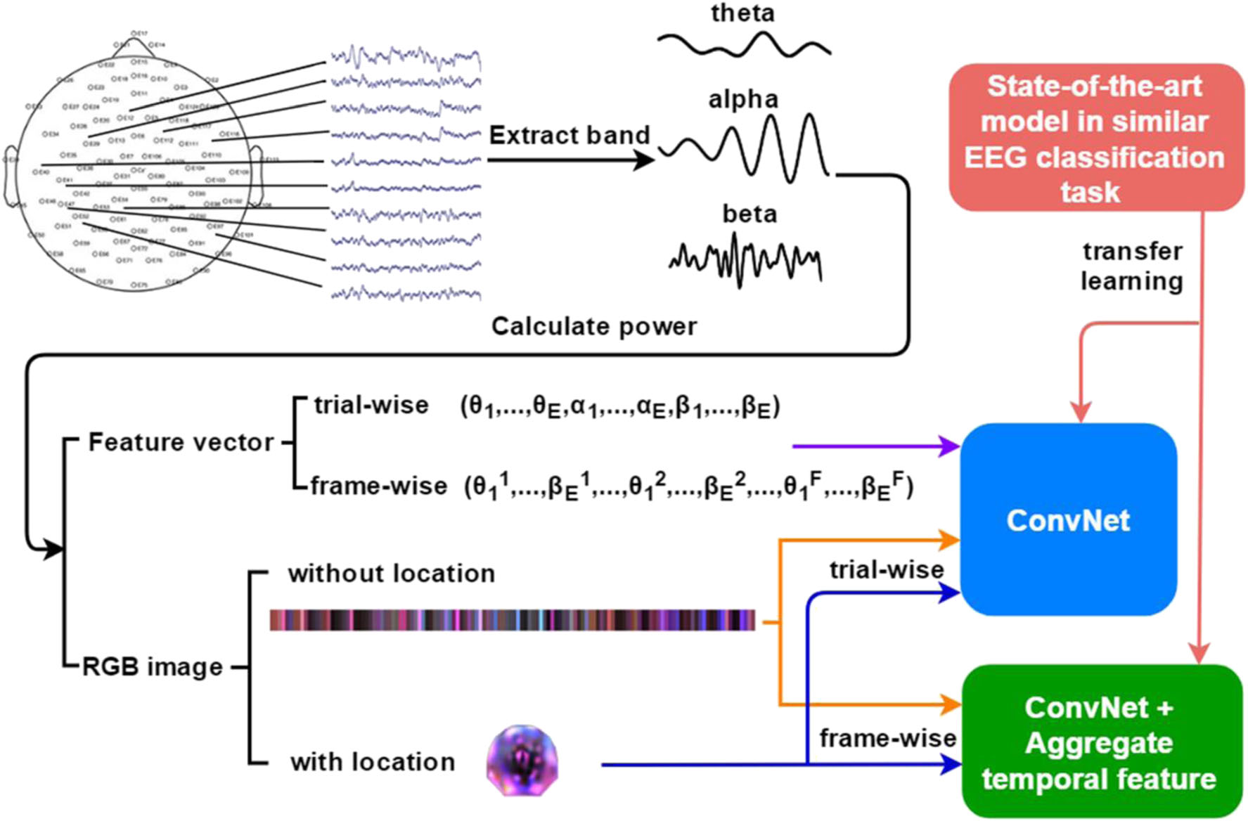
Li et al.46 presented a computer-aided detection system by extracting multiple types of information (e.g., spectral, spatial, and temporal information) to recognize mild depression based on CNN architecture. The authors found that both spectral and temporal information of EEG are crucial for prediction of depression.

Slide 21
Challenges and opportunities
EEG data are usually classified as streaming data that are continuous and are of high density. Despite the initial success in applying DL algorithms to analyze EEG data for studying multiple mental health conditions, there exist several challenges. One major challenge is that raw EEG data gathered from sensors have a certain degree of erroneous, noisy, and redundant information caused by discharged batteries, failures in sensor readings, and intermittent communication loss in wireless sensor networks47. This may challenge the model in extracting meaningful information from noise. Multiple preprocessing steps (e.g., data denoising, data interpolation, data transformation, and data segmentation) are necessary for dealing with the raw EEG signal before feeding to the DL models. Besides, due to the dense characteristics in the raw EEG data, analysis of the streaming data is computationally more expensive, which poses a challenge for the model architecture selection. A proper model should be designed relatively with less training parameters. This is one reason why the reviewed studies are mainly based on the CNN architecture.

Slide 22
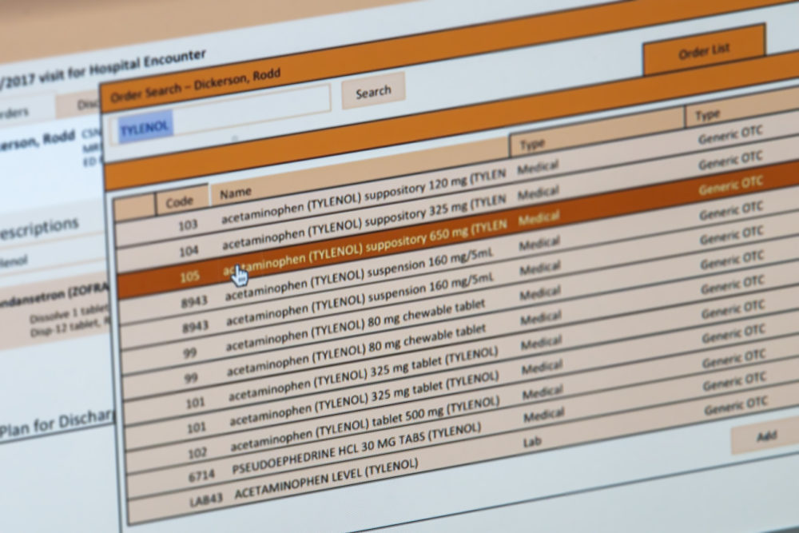
Electronic health records
Electronic health records (EHRs) are systematic collections of longitudinal, patient-centered records. Patients’ EHRs consist of both structured and unstructured data: the structured data include information about a patient’s diagnosis, medications, and laboratory test results, and the unstructured data include information in clinical notes. Recently, DL models have been applied to analyze EHR data to study mental health disorders

Slide 23
For instance, to estimate the probability of suicide deaths, Choi et al.50 leveraged a DFNN to model the baseline characteristics. One major limitation of these studies is the omittance of temporality among the clinical events within EHRs. To overcome this issue, RNNs are more commonly used for EHR data analysis as an RNN intuitively handles time-series data.
DeepCare51, a long short-term memory network (LSTM)-based DL model, encodes patient’s long-term health state trajectories to predict the future outcomes of depressive episodes. As the LSTM architecture appropriately captures disease progression by modeling the illness history and the medical interventions, DeepCare achieved over 15% improvement in prediction, compared with the conventional ML methods.

Slide 24
Machine learning for suicide risk prediction in children and adolescents with electronic health records
Abstract Accurate prediction of suicide risk among children and adolescents within an actionable time frame is an important but challenging task. Very few studies have comprehensively considered the clinical risk factors available to produce quantifiable risk scores for estimation of short- and long-term suicide risk for pediatric population. In this paper, we built machine learning models for predicting suicidal behavior among children and adolescents based on their longitudinal clinical records, and determining short- and long-term risk factors. This retrospective study used deidentified structured electronic health records (EHR) from the Connecticut Children’s Medical Center covering the period from 1 October 2011 to 30 September 2016. Clinical records of 41,721 young patients (10–18 years old) were included for analysis. Candidate predictors included demographics, diagnosis, laboratory tests, and medications. Different prediction windows ranging from 0 to 365 days were adopted. For each prediction window, candidate predictors were first screened by univariate statistical tests, and then a predictive model was built via a sequential forward feature selection procedure. We grouped the selected predictors and estimated their contributions to risk prediction at different prediction window lengths. The developed predictive models predicted suicidal behavior across all prediction windows with AUCs varying from 0.81 to 0.86. For all prediction windows, the models detected 53–62% of suicide-positive subjects with 90% specificity. The models performed better with shorter prediction windows and predictor importance varied across prediction windows, illustrating short- and long-term risks. Our findings demonstrated that routinely collected EHRs can be used to create accurate predictive models for suicide risk among children and adolescents.

Slide 25
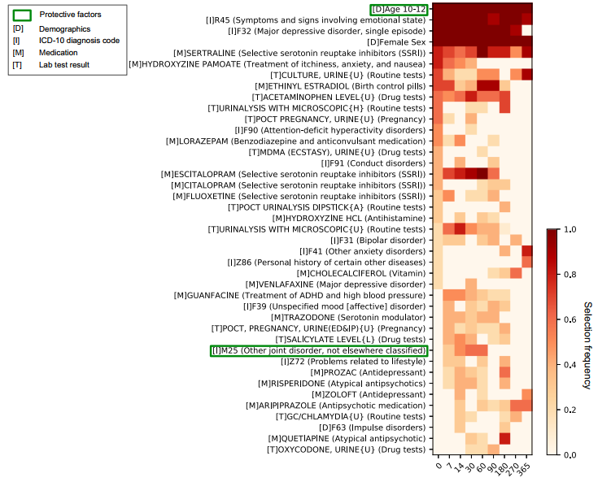

Slide 26
Analyzing the unstructured clinical notes in EHRs refers to the long-standing topic of NLP. To extract meaningful knowledge from the text, conventional NLP approaches mostly define rules or regular expressions before the analysis. However, it is challenging to enumerate all possible rules or regular expressions. Due to the recent advance of DL in NLP tasks, DL models have been developed to mine clinical text data from EHRs to study mental health conditions

Slide 27
Predicting mental conditions based on “history of present illness” in psychiatric notes with deep neural networks
Highlights
•
Psychiatric conditions are predicted based on the “history of present illness” text field.
•
Deep neural networks resulted in a 3% improvement in micro F-score over linear models.
•
Recurrent neural networks (RNNs) with attention helped in model interpretation.
•
CNNs and RNNs complemented each other in per-condition evaluations.

Slide 28
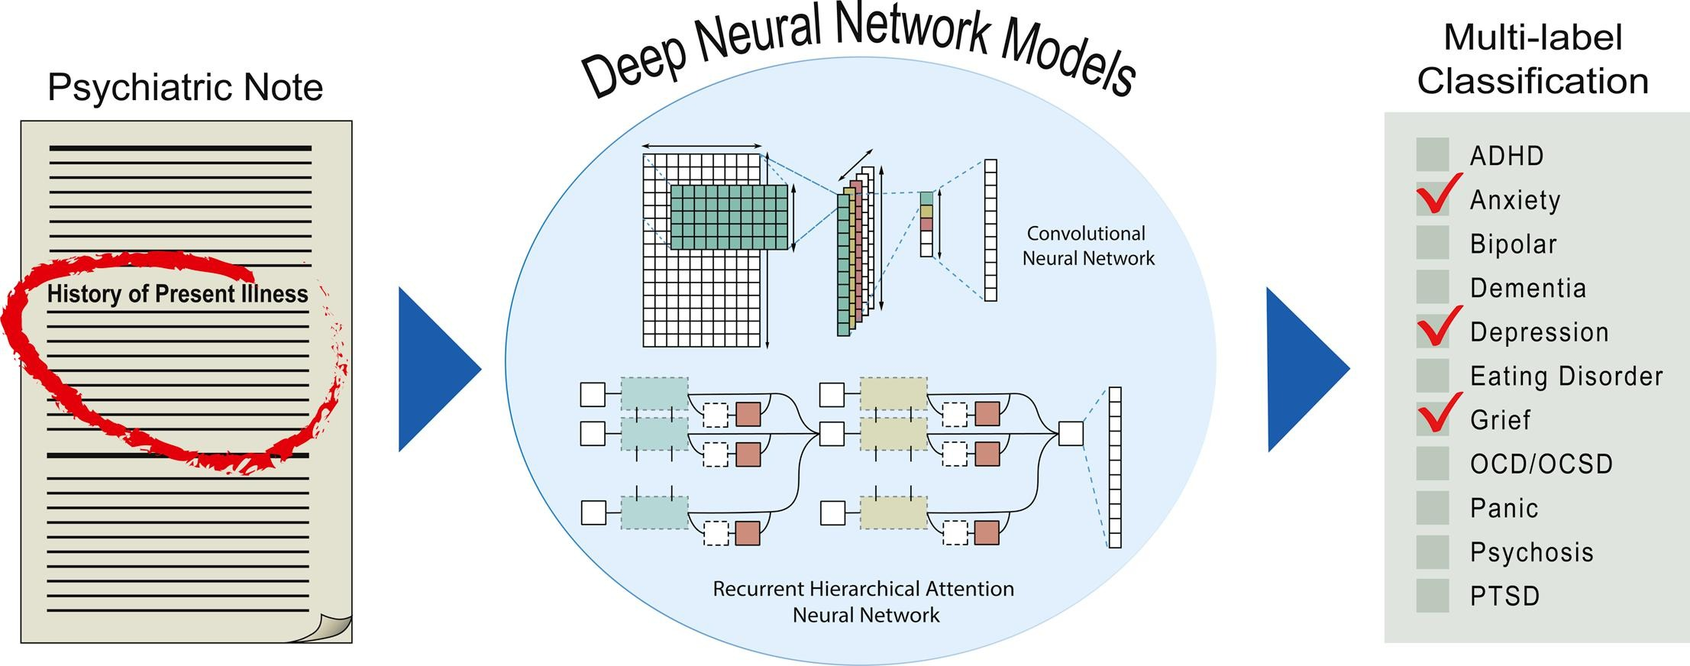
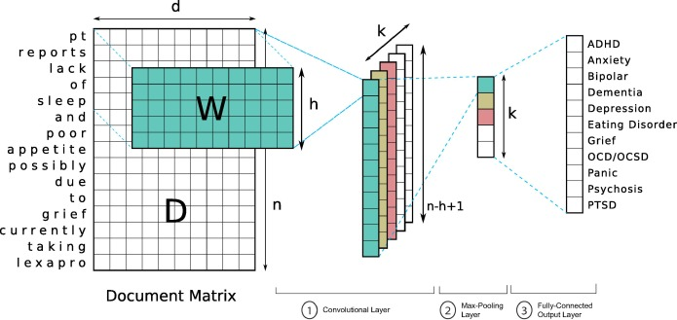

Slide 29
Challenges and opportunities
Although DL has achieved promising results in EHR analysis, several challenges remain unsolved. On one hand, different from diagnosing physical health condition such as diabetes, the diagnosis of mental health conditions lacks direct quantitative tests, such as a blood chemistry test, a buccal swab, or urinalysis. Instead, the clinicians evaluate signs and symptoms through patient interviews and questionnaires during which they gather information based on patient’s self-report. Collection and deriving inferences from such data deeply relies on the experience and subjectivity of the clinician. This may account for signals buried in noise and affect the robustness of the DL model. To address this challenge, a potential way is to comprehensively integrate multimodal clinical information, including structured and unstructured EHR information, as well as neuroimaging and EEG data. Another way is to incorporate existing medical knowledge, which can guide model being trained in the right direction. For instance, the biomedical knowledge bases contain massive verified interactions between biomedical entities, e.g., diseases, genes, and drugs 59. Incorporating such information brings in meaningful medical constraints and may help to reduce the effects of noise on model training process. On the other hand, implementing a DL model trained from one EHR system into another system is challenging, because EHR data collection and representation is rarely standardized across hospitals and clinics. To address this issue, national/international collaborative efforts such as Observational Health Data Sciences and Informatics (https://ohdsi.org) have developed common data models, such as OMOP, to standardize EHR data representation for conducting observational data analysis

Slide 30
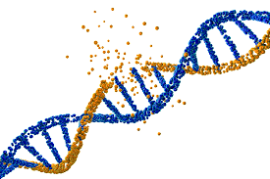
Genetic data
Multiple studies have found that mental disorders, e.g., depression, can be associated with genetic factors61,62. Conventional statistical studies in genetics and genomics, such as genome-wide association studies, have identified many common and rare genetic variants, such as single-nucleotide polymorphisms (SNPs), associated with mental health disorders63,64. Yet, the effect of the genetic factors is small and many more have not been discovered. With the recent developments in next-generation sequencing techniques, a massive volume of high-throughput genome or exome sequencing data are being generated, enabling researchers to study patients with mental health disorders by examining all types of genetic variations across an individual’s genome. In recent years, DL65,66 has been applied to identify genetic risk factors associated with mental illness, by borrowing the capacity of DL in identifying highly complex patterns in large datasets.

Slide 31
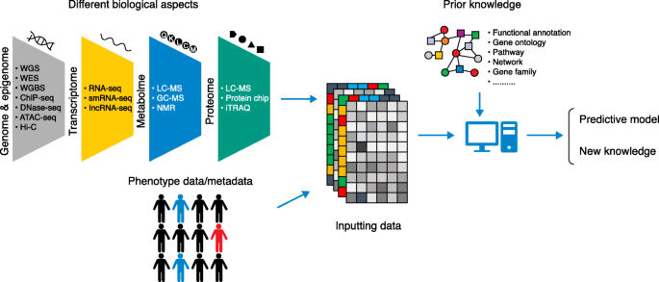
Khan and Wang67 integrated genetic annotations, known brain expression quantitative trait locus, and enhancer/promoter peaks to generate feature vectors of variants, and developed a DFNN, named ncDeepBrain, to prioritized non-coding variants associated with mental disorders. To further prioritize susceptibility genes, they designed another deep model, iMEGES68, which integrates the ncDeepBrain score, general gene scores, and disease-specific scores for estimating gene risk.

Slide 32
Challenges and opportunities
Although the use of genetic data in DL in studying mental health conditions shows promise, multiple challenges need to be addressed. For DL-based risk c/gene prioritization efforts, one major challenge is the limitation of labeled data. On one hand, the positive samples are limited, as known risk SNPs or genes associated with mental health conditions are limited. For example, there are about 108 risk loci that were genome-wide significant in ASD. On the other hand, the negative samples (i.e., SNPs, variants, or genes) may not be the “true” negative, as it is unclear whether they are associated with the mental illness yet. Moreover, it is also challenging to develop DL models for analyzing patient’s sequencing data for mental illness prediction, as the sequencing data are extremely high-dimensional (over five million SNPs in the human genome). More prior domain knowledge is needed to guide the DL model extracting patterns from the high-dimensional genomic space.

Slide 33
Vocal and visual expression data
The use of vocal (voice or speech) and visual (video or image of facial or body behaviors) expression data has gained the attention of many studies in mental health disorders. Modeling the evolution of people’s emotional states from these modalities has been used to identify mental health status. In essence, the voice data are continuous and dense signals, whereas the video data are sequences of frames, i.e., images. Conventional ML models for analyzing such types of data suffer from the sophisticated feature extraction process. Due to the recent success of applying DL in computer vision and sequence data modeling, such models have been introduced to analyze the vocal and/or visual expression data.

Slide 34
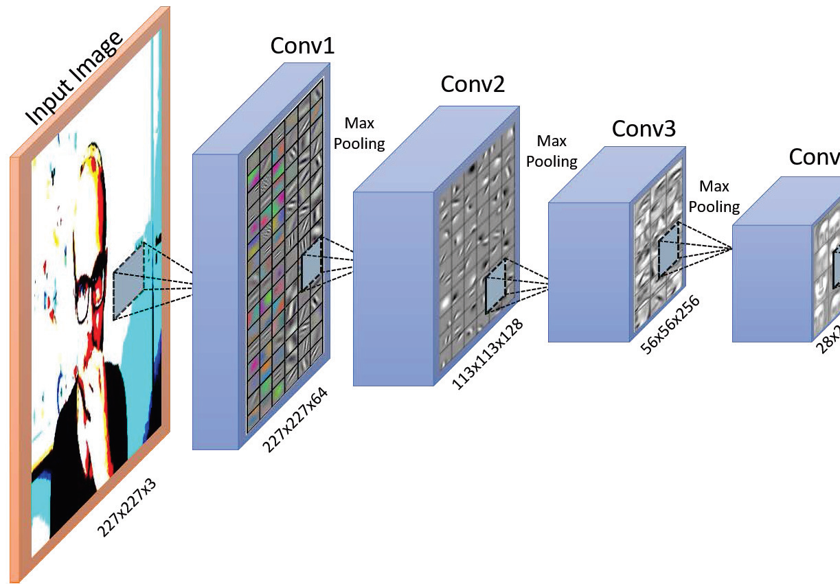
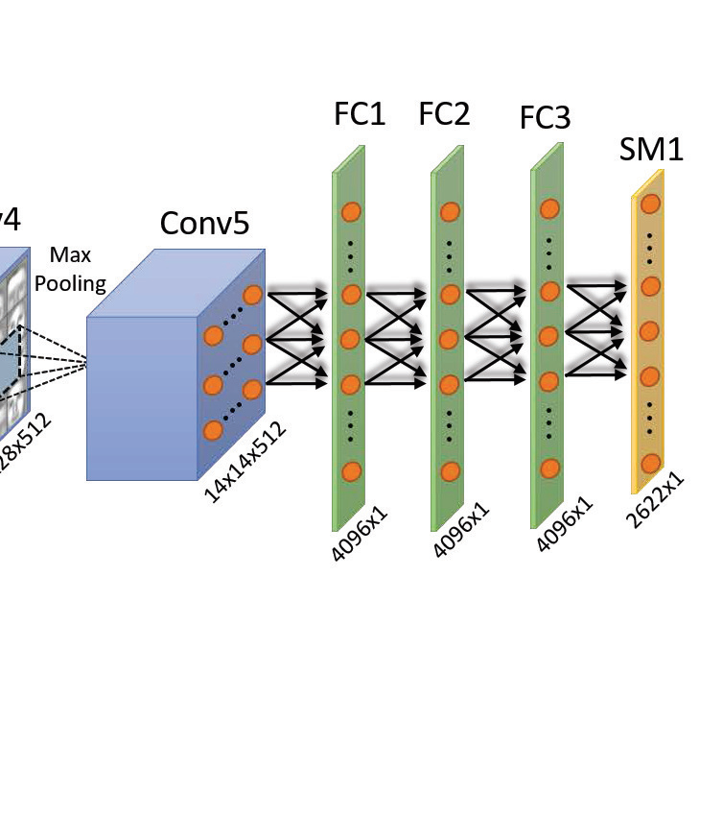
In this work, most articles reviewed are to predict mental health disorders based on two public datasets: (i) the Chi-Mei corpus, collected by using six emotional videos to elicit facial expressions and speech responses of the subjects of bipolar disorder, unipolar depression, and healthy controls;72 and (ii) the International Audio/Visual Emotion Recognition Challenges (AVEC) depression dataset73,74,75, collected within human–computer interaction scenario.

Slide 35
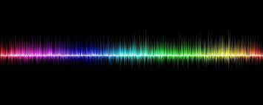
Current studies analyzed vocal and visual expression over individual datasets. Without clinical guidance, the developed prediction models have limited clinical meanings. Linking patients’ expression information with clinical variables may help to improve both the interpretability and robustness of the model.

Slide 36
Social media data
With the widespread proliferation of social media platforms, such as Twitter and Reddit, individuals are increasingly and publicly sharing information about their mood, behavior, and any ailments one might be suffering. Such social media data have been used to identify users’ mental health state (e.g., psychological stress and suicidal ideation)

